Slide 1
Mininet Agents
Supporting Built In Monitoring Agents In Mininet
Presented by: Shira Levy & Sivan Oddes
Guided by: Itzik Ashkenazi & Jalil Morany

Slide 2
Introduction
Node
Agent
Switch
Controller
Host

Slide 3
Our Work Flow
Studying the mininet code and infrastructure
A little OpenFlow protocol reading
Midterm presentation
Creating an agent & implementing it into the mininet infrastructure
Creating & Preforming use case example
Final presentation!

Slide 4
Our Work Flow
studying the mininet code
creating an agent
creating use case example

Slide 5
MININET LIGHT SCHEME- block diagram
mn
creates mininet object with the requested type of topo, agent, switch, controller..
once the requested network initialized:
mn.start()
mn.stop()
net
creates the network and connects components to be up and running
contains mininet class
build topo as requested
start switches, agents and controllers.
stop
node
class Node
class Agent(Node)
class OpenFlowAgent(Agent)
class Host, Switch, controller
topo
class topo – adds all components to the graph
class SingleSwitchAndAgentTopo(Topo)
class TwoSwitchAndAgentTopo(Topo)
studying the mininet code
creating an agent
creating use case example

Slide 6
CREATING AN AGENT
studying the mininet code
creating an agent
creating use case example
Agent is a subclass node that monitors a switch
Wanted it to run as a host (which is a node)
Connect to the switch as a controller does
It can connect to any switch
The monitoring options are user define

Slide 7
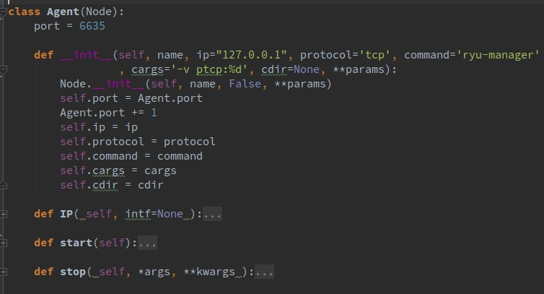
AGENT TYPE NODE
studying the mininet code
creating an agent
creating use case example
Uses port 6635+
Namespace=none. same “Network namespace” as controller and switch
Protocol=TCP
IP= 127.0.0.1
Runs Ryu-manager application (for use cases based OpenFlow)
Def - Start, Stop, ip

Slide 8
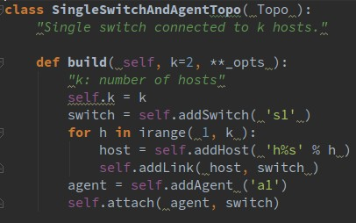
BUILDING AGENT TOPOLOGY EXAMPLE
studying the mininet code
creating an agent
creating use case example
c0
h1
s1
h2
a1

Slide 9
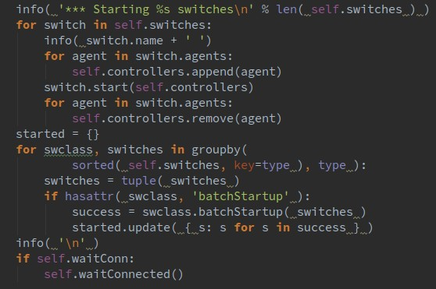
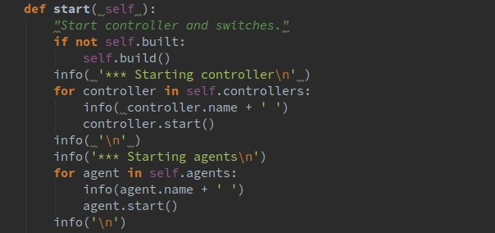
STARTING THE NETWORK
studying the mininet code
creating an agent
creating use case example

Slide 10
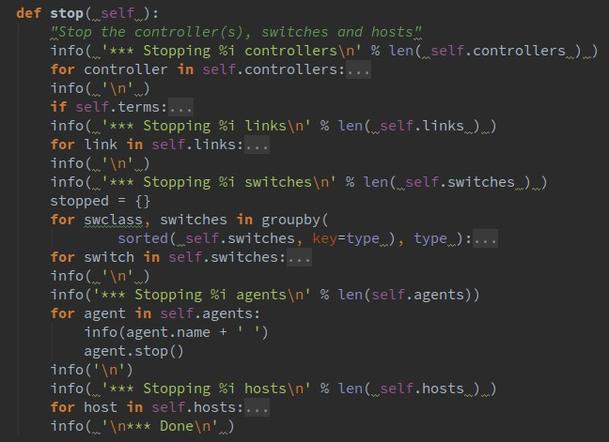

STOPING THE NETWORK
studying the mininet code
creating an agent
creating use case example

Slide 11
studying the mininet code
creating an agent
creating use case example
CLI / LIVE SIMULATION

Slide 12
OpenFlow based USE CASES
studying the mininet code
creating an agent
creating use case example
Creating a new agent subclass named OpenFlowAgent(Agent):
it communicates with switch using OpenFlow
Agent(Node)
OpenFlowAgent(Agent)
SamplingAgent(OpenFlowAgent)
SecAgent(OpenFlowAgent)
Notes:
להסביר שבsimple switch 13 כל חבילה שמגיעה, נשלחת לhost המתאים

Slide 13
OpenFlow based USE CASES
studying the mininet code
creating an agent
creating use case example
Creating a new OpenFlowAgent subclass
The agent uses Ryu Modules to implement the use cases
The agent behaves according to the instructions that are determined by it’s Module.
The Module defines what the agent does for each event (for example, when a packet arrives)
Using these events instructions we fulfill the monitoring we want on the switch
Notes:
להסביר שבsimple switch 13 כל חבילה שמגיעה, נשלחת לhost המתאים

Slide 14
USE CASE- SamplingAgent
studying the mininet code
creating an agent
creating use case example
Create a new subclass SamplingAgent(OpenFlowAgent)
Adding a new Ryu Module for SamplingAgent
This module supplies us with a packet sample - every five packets
Notes:
להסביר שנשלחת חבילה לagent table שמספרו 1 והוא מוסיף פקודה שאומרת לזרוק את כל ההודעות שיגיעו בחמש שניות הבאות אחרי החבילה הזאת.

Slide 15
studying the mininet code
creating an agent
creating use case example
USE CASE SIMULATION
number 1

Slide 16
USE CASE- SecAgent
studying the mininet code
creating an agent
creating use case example
Create a new subclass SecAgent(OpenFlowAgent)
Adding a new Ryu Module for SecAgent
The Module adds a flow to switch with timeout 2sec
Notes:
להסביר שנשלחת חבילה לagent table שמספרו 1 והוא מוסיף פקודה שאומרת לזרוק את כל ההודעות שיגיעו בחמש שניות הבאות אחרי החבילה הזאת.

Slide 17
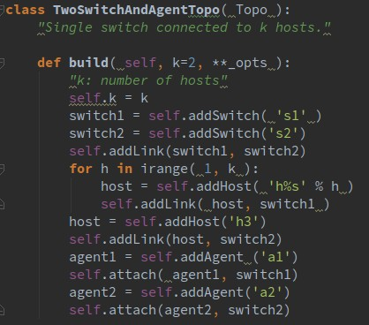
Another topology-for the second use case
c0
a1
a2
s1
s2
h1
h2
h3

Slide 18
studying the mininet code
creating an agent
creating use case example
USE CASE SIMULATION
number 2

Slide 19
Network-wise top-k detection
c0
local_top_k:
5.11.0.0/16
local_top_k:
192.168.0.0/16,
211.17.0.0/16
a4
local_top_k:
192.168.0.0/16
5.11.0.0/16
a1
s4
a3
s1
s3
a2
s2
local_top_k:
211.17.0.0/16

Slide 20
Monitoring Future → today ☺
Agent monitoring-
By creating agents we introduced a new monitoring infrastructure to Mininet.
Not limited-
No limitation on the information-type the agent provides.
Easily user defined-
Added built-in support to the monitoring capabilities.
Decreased the load-
Through local/remote communication decreasing the load from the controller.
Notes:
This are the things that we are going to achieve:

Slide 21
Agent future enhancements
Enabling remote communication to the agent.
Extending the agent infrastructure on agents side-
Adding more use cases that will form an easy to use toolbox which will make the agent more accessible for users!
Creating an agent environment that will store data in an organized way.
Developing a management environment for several queries that run simultaneously.

Slide 22
The things we learned
Mininet:
mininet code
network topology
messages flow
Open source on mininet community
Basic OpenFlow protocol
Languages and Technologies:
git
Python

Slide 23

THE END
Thank you!

